Slide 1
PROJECT NAME – WEB PORTAL FOR LAWYERS
PROJECT ID – SGH001759
TEAM MEMBERS:
ZINAL THAKKAR
KAUMIL PATEL
HIREN LATHIYA
HARSHIL KHATRI
MANISH PALIWAL
DIPALI RANGPARIYA
DHRUV PATEL
MENTOR: DHAVAL PRAJAPATI

Slide 2
Modules
In our system we have provide three modules:-
1)Admin(super admin , sub admin)
2)Lawyer
3)Client

Slide 3
Admin
There are two admin one is super admin and another is sub admin.
Super admin can add sub admin and can manage sub admin.
Both super and sub admin can add and manage lawyer.
Both admin can view clients and cases which are under each and every lawyer.
Admins can view case details , hearing details , case status and documents of every case.
Admin can add rule sections and can also search for it.
Admin can also see the feedback send by the client.
Admin can view contact in which lawyer request admin to add him/her as a lawyer and after verifying lawyer’s enrollment number admin add him/her as lawyer.

Slide 4
Lawyer
Lawyer can add and manage clients, opponents and opponent advocates.
Lawyer can add case and manage open and close cases.
Lawyer can add hearing details, case status of every case and can view documents which are upload by the clients.
Lawyer can search rules sections, send sms and email to client.
There is a chat mechanism which are access by lawyer and client.

Slide 5
Client
Client can communicate to lawyer via chat mechanism.
Client can view it’s case status and send documents to lawyer for backup.
Client can send feedback to admin about lawyer and our system.

Slide 6
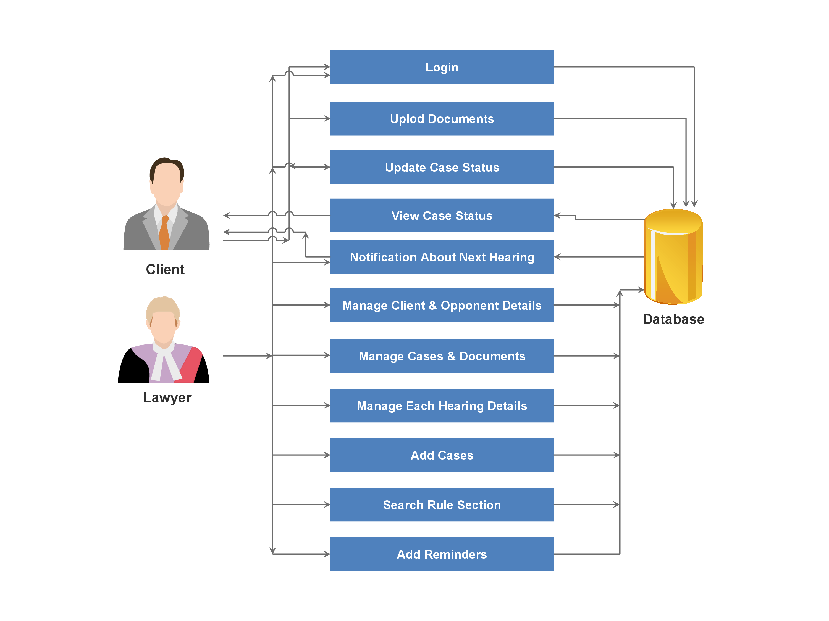

Slide 7
TOOLS AND TECHNOLOGY
Php
MySql
HTML 5
CSS 3
Bootstrap
JavaScript
XAMPP
Sublime Text Editor

Slide 8
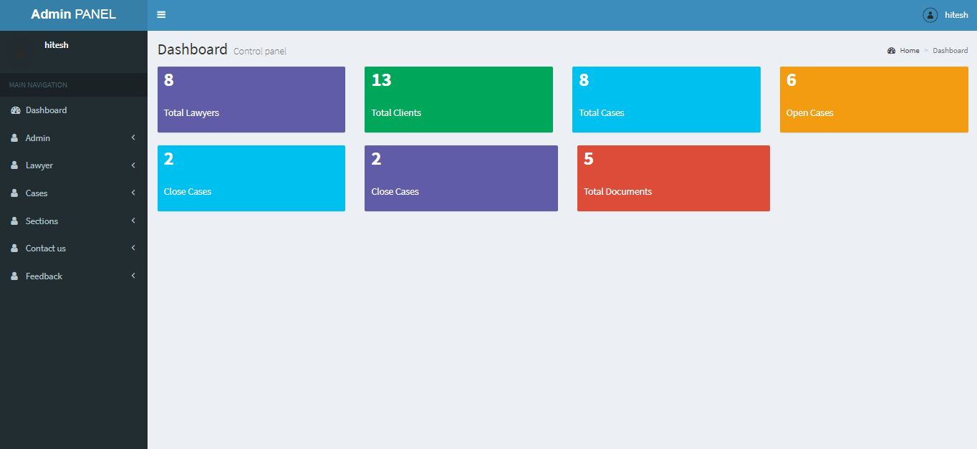

Slide 9
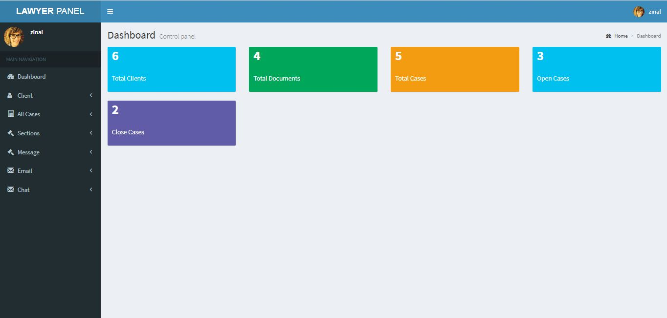

Slide 10
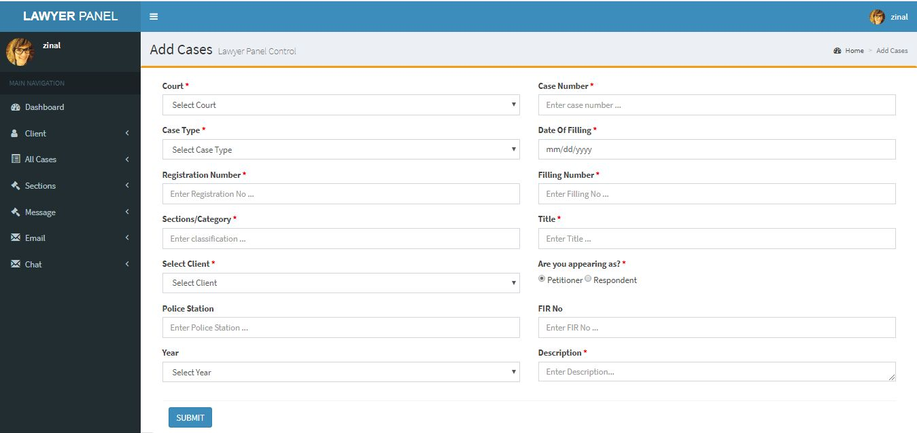

Slide 11
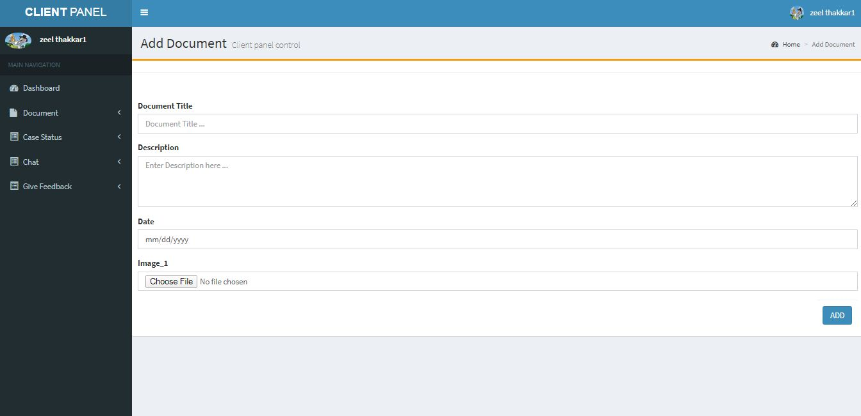

Slide 12
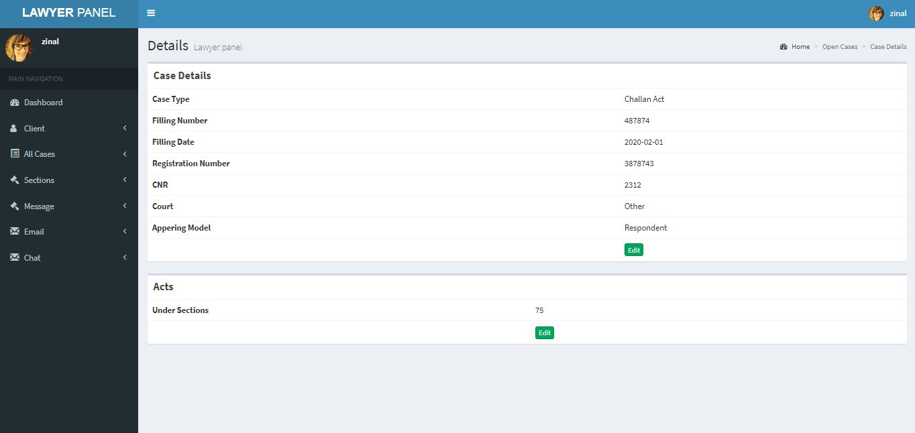

Slide 13
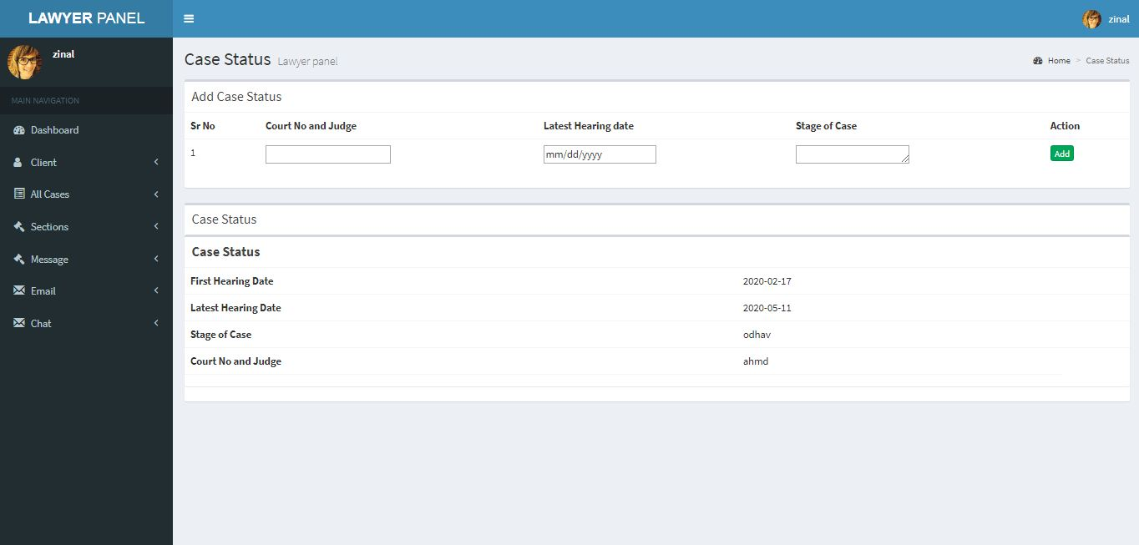

Slide 14
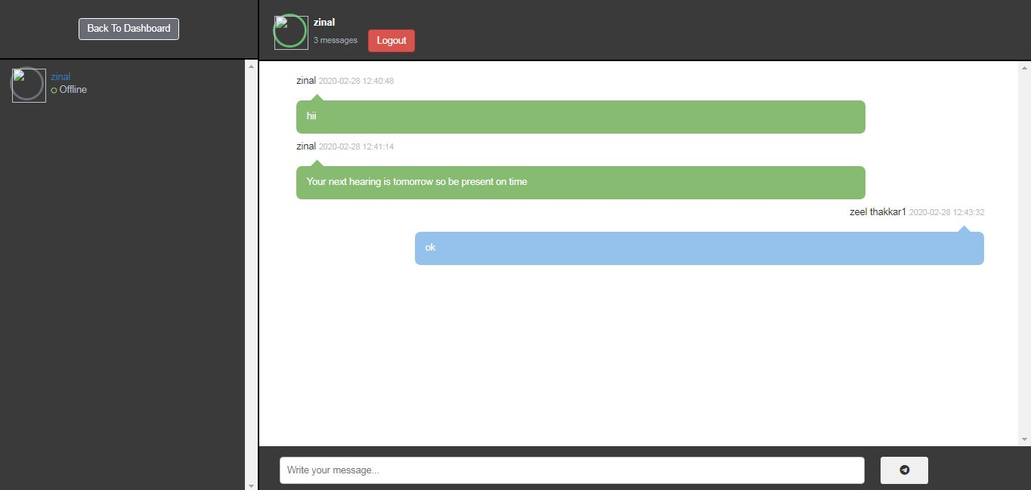

Slide 15
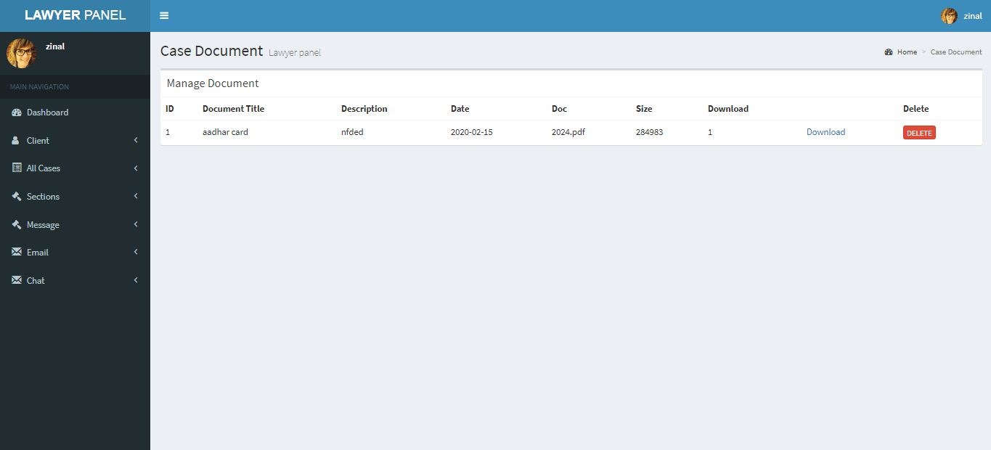

Slide 16
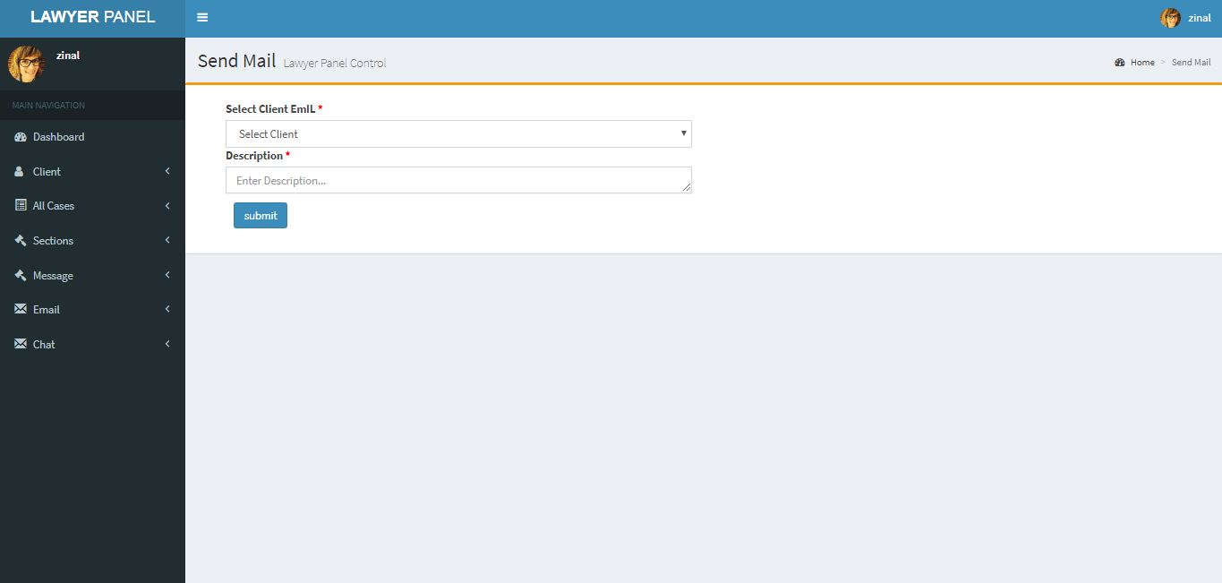

Slide 17
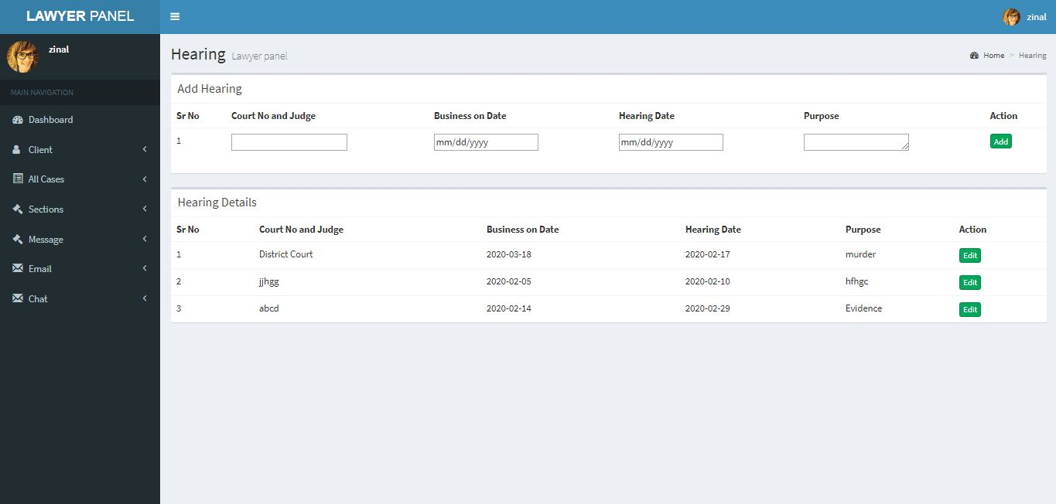

Slide 18
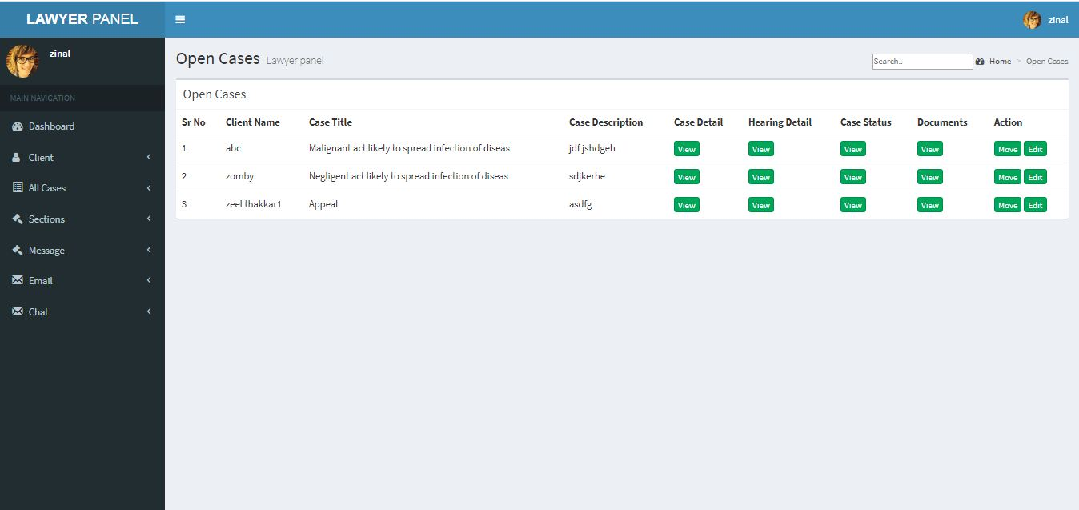

Slide 19
